Slide 1
Properties of Regular Languages

Slide 2
Some languages are not regular
When is a language is regular? if we are able to construct one of the following: DFA or NFA or ε -NFA or regular expression
When is it not? If we can show that no FA can be built for a language
eg: L = {w | w is of the form 0^{n}1^{n} , for all n≥0}
Properties of RL:
Closure properties of Regular Languages(RL)
Homomorphisms
The Pumping Lemma for Regular Languages

Slide 3
1. Closure properties of Regular Languages(RL)
Closure property:
If a set of regular languages are combined using an operator, then the resulting language is also regular
Regular languages are closed under:
Union, intersection, complement, difference
Reversal
Kleene closure
Concatenation
Homomorphism
Right Quotient

Slide 4
i. RL’s are closed under union
IF L and M are two RLs THEN:
They both have two corresponding regular expressions, R and S respectively
(L U M) can be represented using the regular expression R+S
Therefore, (L U M) is also regular

Slide 5
ii. RL’s are closed under complementation
If L is an RL over ∑, then L=∑*-L
To show L is also regular, consider the following construction
DFA for L
q_{F1}
q₀
q_{i}
q_{F2}
Convert every final state into non-final, and
every non-final state into a final state
…
q_{Fk}

Slide 6
DFA for L
q_{F1}
q₀
q_{i}
q_{F2}
…
q_{Fk}

Slide 7
iii. RL’s are closed under intersection
A quick, indirect way to prove:
By DeMorgan’s law:
L ∩ M = (L U M)
Since we know RLs are closed under union and complementation, they are also closed under intersection
A more direct way would be construct a finite automaton for L ∩ M

Slide 8
DFA construction for L ∩ M
A_{L} = DFA for L = {Q_{L}, ∑ , q_{L},F_{L}, δ_{L} }
A_{M} = DFA for M = {Q_{M}, ∑ , q_{M},F_{M}, δ_{M} }
Build A_{L ∩ M} = {Q_{L}x Q_{M},∑, (q_{L},q_{M}), F_{L}x F_{M},δ} such that:
δ((p,q),a) = (δ_{L}(p,a), δ_{M}(q,a)), where p in Q_{L}, and q in Q_{M}
This construction ensures that a string w will be accepted if and only if w reaches an accepting state in both input DFAs.

Slide 9
DFA construction for L ∩ M
DFA for L
DFA for M
q_{F1}
p_{F1}
a
a
q₀
q_{i}
q_{j}
q_{F2}
p₀
p_{i}
p_{j}
p_{F2}
…
…
DFA for L∩M
(q_{F1} ,p_{F1})
(q₀ ,p₀)
(q_{i} ,p_{i})
a
(q_{j} ,p_{j})
…

Slide 10
iv. RL’s are closed under set difference
Closed under intersection
We observe:
L - M = L ∩ M
Therefore, L - M is also regular
Closed under complementation

Slide 11
v. RL’s are closed under reversal
Reversal of a string w is denoted by w^{R}
E.g., w=00111, w^{R}=11100
Reversal of a language:
L^{R} = The language generated by reversing all strings in L
Theorem: If L is regular then L^{R} is also regular

Slide 12
ε -NFA Construction for L^{R}
New ε-NFA for L^{R}
DFA for L
q_{F1}
ε
q₀
q_{i}
a
q_{j}
q_{F2}
ε
q’₀
New start
state
Make the old start state as the only new final state
…
ε
q_{Fk}
What to do if q₀ was one of the final states in the input DFA?
Reverse all transitions
Convert the old set of final states into non-final states
Add a ε transistion from q0’ to q0

Slide 13
2.Homomorphisms
Substitute each symbol in ∑ (main alphabet) by a corresponding string in T (another alphabet)
h: ∑--->T*
Example:
Let ∑={0,1} and T={a,b}
Let a homomorphic function h on ∑ be:
h(0)=ab, h(1)=ε
If w=10110, then h(w) = εabεεab = abab
In general,
h(w) = h(a₁) h(a₂)… h(a_{n})

Slide 14
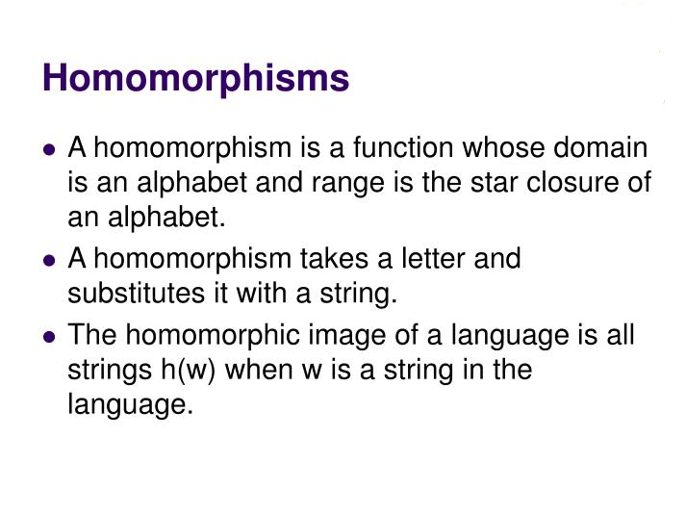

Slide 15
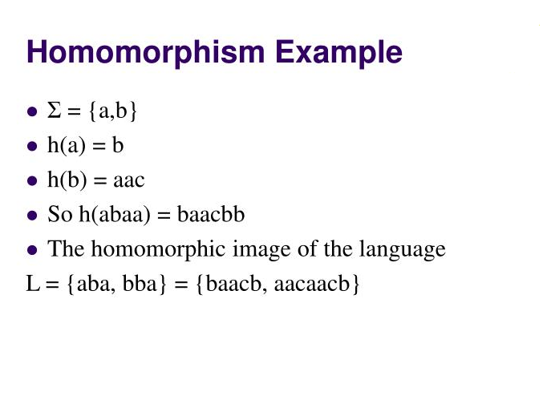

Slide 16
FA Construction for h(L)
Given a DFA for L, how to convert it into an FA for h(L)?
Replace every edge “a” by a path labeled h(a) in the new DFA
DFA for L
q_{F1}
q₀
q_{i}
a
q_{j}
q_{F2}
h(a)
…
q_{Fk}
Build a new FA that simulates h(a) for every symbol a transition in the above DFA
The resulting FA may or may not be a DFA, but will be a FA for h(L)

Slide 17
3. The Pumping Lemma for Regular Languages
What it is? The Pumping Lemma is a property of all regular languages.
How is it used? A technique that is used to show that a given language is not regular

Slide 18
Pumping Lemma for Regular Languages
Let L be a regular language
Then there exists some constant N such that for every string w ∈ L s.t. |w|≥N, there exists a way to break w into three parts, w=xyz, such that:
y≠ ε
|xy|≤N
For all k≥0, all strings of the form xy^{k}z ∈ L
This property should hold for all regular languages.
Definition: N is called the “Pumping Lemma Constant”

Slide 19
How to use the pumping lemma?
Think of playing a 2 person game
Role 1: We claim that the language cannot be regular
Role 2: An adversary who claims the language is regular
We show that the adversary’s statement will lead to a contradiction that implies pumping lemma cannot hold for the language.
We win!!

Slide 20
How to use the pumping lemma? (The Steps)
(we) L is not regular.
(adv.) Claims that L is regular and gives you a value for N as its P/L constant
(we) Using N, choose a string w ∈ L s.t.,
|w| ≥ N,
Using w as the template, construct other words w_{k} of the form xy^{k}z and show that at least one such w_{k} ∉ L
=> this implies we have successfully broken the pumping lemma for the language, and hence that the adversary is wrong.
(Note: In this process, we may have to try many values of k, starting with k=0, and then 2, 3, .. so on, until w_{k} ∉ L )

Slide 21
Using the Pumping Lemma
Note: We don’t have any control over N, except that it is positive. We also don’t have any control over how to split w=xyz, but xyz should respect the P/L conditions (1) and (2).
What WE do?
3. Using N, we construct our template string w
4. Demonstrate to the adversary, either through pumping up or down on w, that some string w_{k} ∉ L (this should happen regardless of w=xyz)
What the Adversary does?
1. Claims L is regular
2. Provides N

Slide 22
Example of using the Pumping Lemma to prove that a language is not regular
Note: This N can be anything (need not necessarily be the #states in the DFA. It’s the adversary’s choice.)
Let L_{eq} = {w | w is a binary string with equal number of 1s and 0s}
Your Claim: L_{eq} is not regular
Proof:
By contradiction, let L_{eq} be regular
P/L constant should exist
Let N = that P/L constant
Consider input w = 0^{N}1^{N} (your choice for the template string)
By pumping lemma, we should be able to break w=xyz, such that:
y≠ ε
|xy|≤N
For all k≥0, the string xy^{k}z is also in L
➔ adv.
➔ adv.
➔ you
➔you

Slide 23
Proof…
Template string w = 0^{N}1^{N} = 00 …. 011 … 1
N
N
Because |xy|≤N, xy should contain only 0s
(This and because y≠ ε, implies y=0⁺)
Therefore x can contain at most N-1 0s
Also, all the N 1s must be inside z
By (3), any string of the form xy^{k}z ∈ L_{eq} for all k≥0
Case k=0: xz has at most N-1 0s but has N 1s
Therefore, xy⁰z ∉ L_{eq}
This violates the P/L (a contradiction)
➔ you
Setting k=0 is referred to as “pumping down”
Another way of proving this will be to show that if the #0s is arbitrarily pumped up (e.g., k=2), then the #0s will become exceed the #1s
Setting k>1 is referred to as “pumping up”

Slide 24
Exercise 2
Prove L = {0^{n}10^{n} | n≥ 1} is not regular
Note: This n is not to be confused with the pumping lemma constant N. That can be different.
In other words, the above question is same as proving:
L = {0^{m}10^{m} | m≥ 1} is not regular

Slide 25
Example 3: Pumping Lemma
Claim: L = { 0^{i} | i is a perfect square} is not regular
Proof:
By contradiction, let L be regular.
P/L should apply
Let N = P/L constant
Choose w=0^{N2}
By pumping lemma, w=xyz satisfying all three rules
By rules (1) & (2), y has between 1 and N 0s
By rule (3), any string of the form xy^{k}z is also in L for all k≥0
Case k=0:
#zeros (xy⁰z) = #zeros (xyz) - #zeros (y)
N² – N ≤ #zeros (xy⁰z) ≤ N² - 1
(N-1)² < N² - N ≤ #zeros (xy⁰z) ≤ N² - 1 < N²
xy⁰z ∉ L
But the above will complete the proof ONLY IF N>1.
… (proof contd.. Next slide)

Slide 26
Example 3: Pumping Lemma
(proof contd…)
If the adversary pick N=1, then (N-1)² ≤ N² – N, and therefore the #zeros(xy⁰z) could end up being a perfect square!
This means that pumping down (i.e., setting k=0) is not giving us the proof!
So lets try pumping up next…
Case k=2:
#zeros (xy²z) = #zeros (xyz) + #zeros (y)
N² + 1 ≤ #zeros (xy²z) ≤ N² + N
N² < N² + 1 ≤ #zeros (xy²z) ≤ N² + N < (N+1)²
xy²z ∉ L
(Notice that the above should hold for all possible N values of N>0. Therefore, this completes the proof.)

Slide 27
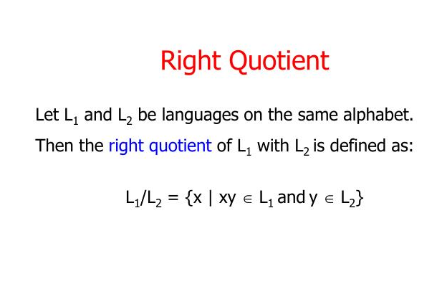

Slide 28
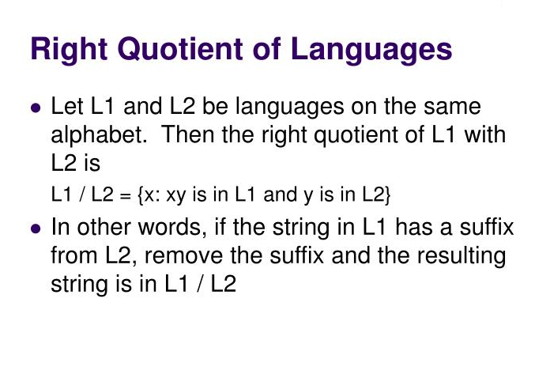

Slide 29
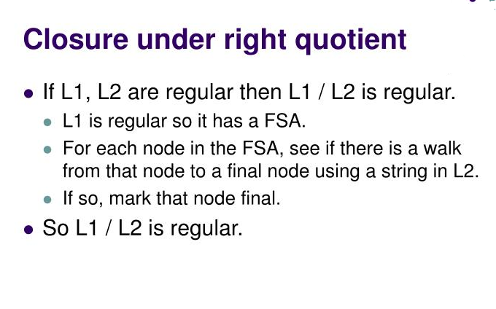

Slide 30
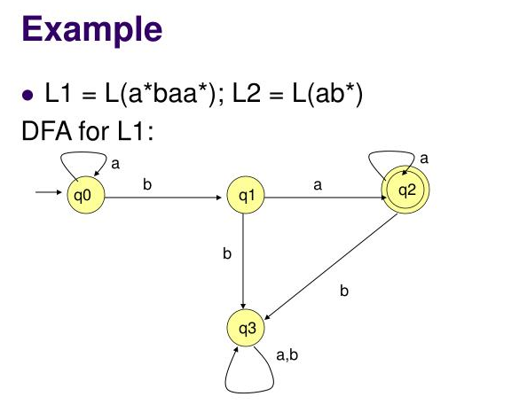

Slide 31
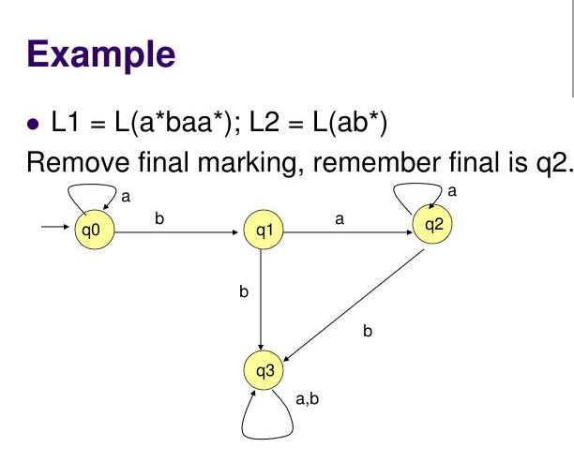

Slide 32
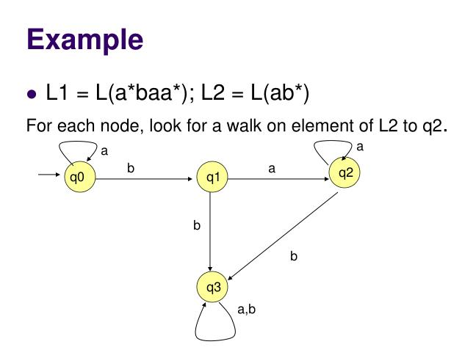

Slide 33
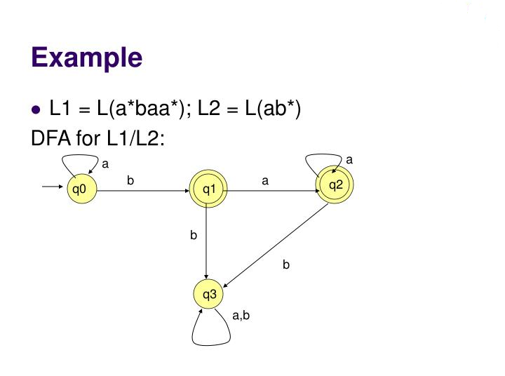

Slide 34
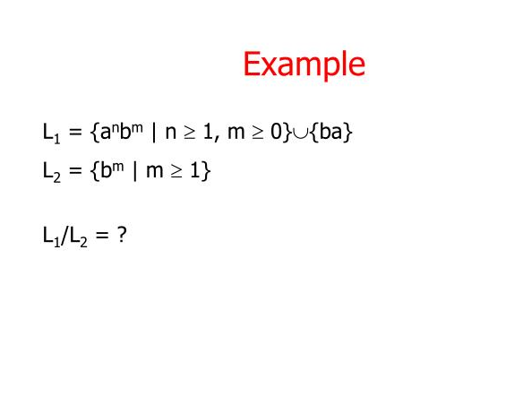

Slide 35
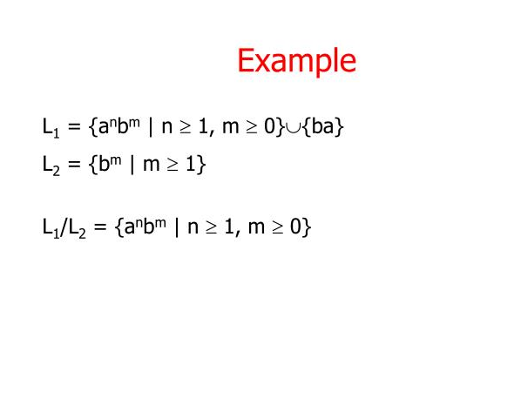

Slide 36
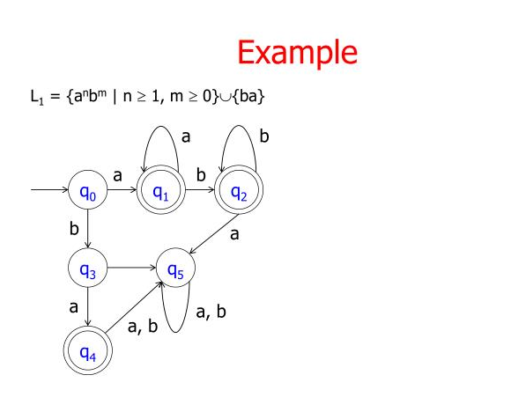

Slide 37
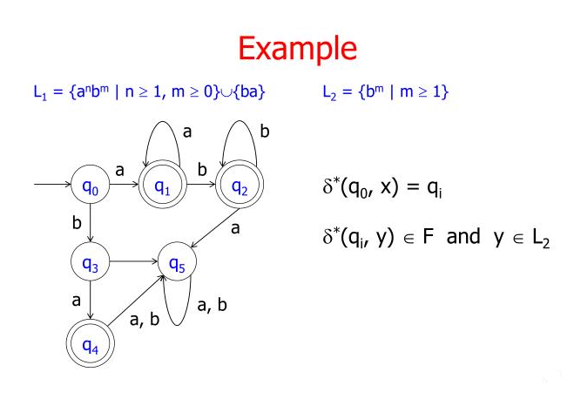

Slide 38
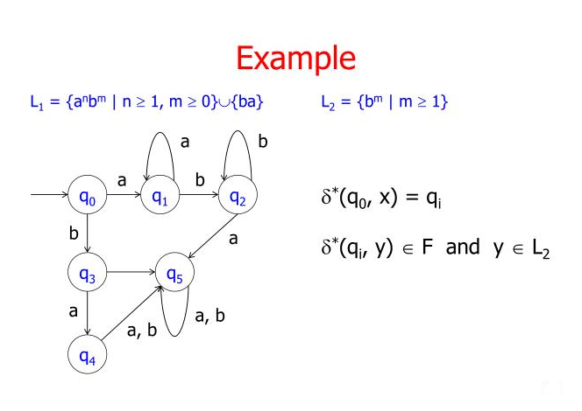

Slide 39
Thank you

